Slide 1


Slide 2





Output Label (Image class)
Input Image
CNN

Slide 3





















Happy
CNN
CNN
Sad

Slide 4


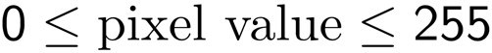







B / W Image 2x2px
Pixel 1
Pixel 2
Pixel 1
Pixel 2
2d array
Pixel 3
Pixel 4
Pixel 3
Pixel 4
Colored Image 2x2px
Red channel
Green channel
Pixel 1
Pixel 2
Colored Image
Pixel 2
3d array
Pixel 1
Colored Image
Pixel 3
Pixel 4
Pixel 3
Pixel 4
Blue channel

Slide 5





0 | 0 | 0 | 0 | 0 | 0 | 0
0 | 1 | 0 | 0 | 0 | 1 | 0
0 | 0 | 0 | 0 | 0 | 0 | 0
0 | 0 | 0 | 1 | 0 | 0 | 0
0 | 1 | 0 | 0 | 0 | 1 | 0
0 | 0 | 1 | 1 | 1 | 0 | 0
0 | 0 | 0 | 0 | 0 | 0 | 0

Slide 6
STEP 1: Convolution
STEP 2: Max Pooling STEP 3: Flattening STEP 4: Full Connection

Slide 7

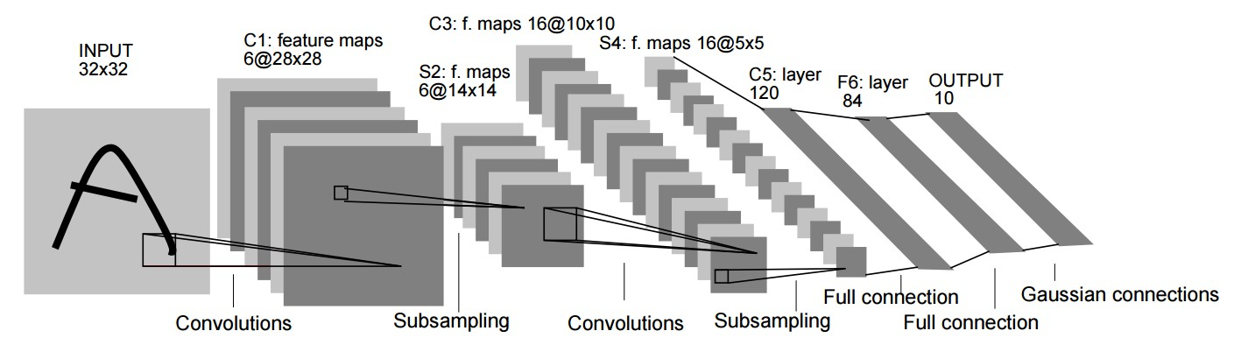
Additional Reading:
Gradient-Based Learning Applied to Document Recognition
By Yann LeCun et al. (1998) Link:
http://yann.lecun.com/exdb/publis/pdf/lecun-01a.pdf

Slide 8






Slide 9





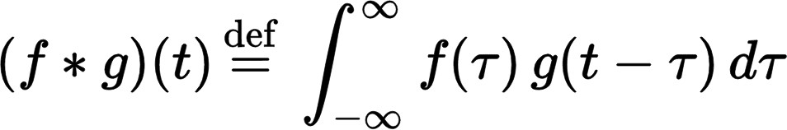

Slide 10

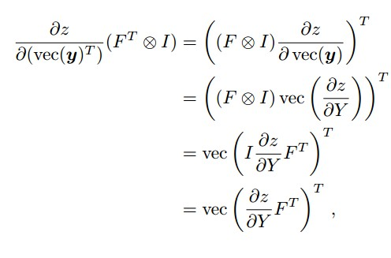
Additional Reading:
Introduction to Convolutional Neural Networks
By Jianxin Wu (2017)
Link:
http://cs.nju.edu.cn/wujx/paper/CNN.pdf

Slide 11







0 | 0 | 0 | 0 | 0 | 0 | 0
0 | 1 | 0 | 0 | 0 | 1 | 0
0 | 0 | 0 | 0 | 0 | 0 | 0
0 | 0 | 0 | 1 | 0 | 0 | 0
0 | 1 | 0 | 0 | 0 | 1 | 0
0 | 0 | 1 | 1 | 1 | 0 | 0
0 | 0 | 0 | 0 | 0 | 0 | 0
0 | 0 | 1
1 | 0 | 0
0 | 1 | 1
0 | 1 | 0 | 0 | 0
0 | 1 | 1 | 1 | 0
1 | 0 | 1 | 2 | 1
1 | 4 | 2
Input Image
Feature Detector
Feature Map

Slide 12

0 | 0 | 0 | 0 | 0 | 0 | 0
0 | 1 | 0 | 0 | 0 | 1 | 0
0 | 0 | 0 | 0 | 0 | 0 | 0
0 | 0 | 0 | 1 | 0 | 0 | 0
0 | 1 | 0 | 0 | 0 | 1 | 0
0 | 0 | 1 | 1 | 1 | 0 | 0
0 | 0 | 0 | 0 | 0 | 0 | 0
0 | 0 | 1
1 | 0 | 0
0 | 1 | 1
0 | 1 | 0 | 0 | 0
0 | 1 | 1 | 1 | 0
1 | 0 | 1 | 2 | 1
1 | 4 | 2 | 1
Input Image
Feature Detector
Feature Map

Slide 13

0 | 0 | 0 | 0 | 0 | 0 | 0
0 | 1 | 0 | 0 | 0 | 1 | 0
0 | 0 | 0 | 0 | 0 | 0 | 0
0 | 0 | 0 | 1 | 0 | 0 | 0
0 | 1 | 0 | 0 | 0 | 1 | 0
0 | 0 | 1 | 1 | 1 | 0 | 0
0 | 0 | 0 | 0 | 0 | 0 | 0
0 | 0 | 1
1 | 0 | 0
0 | 1 | 1
0 | 1 | 0 | 0 | 0
0 | 1 | 1 | 1 | 0
1 | 0 | 1 | 2 | 1
1 | 4 | 2 | 1 | 0
Input Image
Feature Detector
Feature Map

Slide 14

0 | 0 | 0 | 0 | 0 | 0 | 0
0 | 1 | 0 | 0 | 0 | 1 | 0
0 | 0 | 0 | 0 | 0 | 0 | 0
0 | 0 | 0 | 1 | 0 | 0 | 0
0 | 1 | 0 | 0 | 0 | 1 | 0
0 | 0 | 1 | 1 | 1 | 0 | 0
0 | 0 | 0 | 0 | 0 | 0 | 0
0 | 0 | 1
1 | 0 | 0
0 | 1 | 1
0 | 1 | 0 | 0 | 0
0 | 1 | 1 | 1 | 0
1 | 0 | 1 | 2 | 1
1 | 4 | 2 | 1 | 0
0
Input Image
Feature Detector
Feature Map

Slide 15

0 | 0 | 0 | 0 | 0 | 0 | 0
0 | 1 | 0 | 0 | 0 | 1 | 0
0 | 0 | 0 | 0 | 0 | 0 | 0
0 | 0 | 0 | 1 | 0 | 0 | 0
0 | 1 | 0 | 0 | 0 | 1 | 0
0 | 0 | 1 | 1 | 1 | 0 | 0
0 | 0 | 0 | 0 | 0 | 0 | 0
0 | 0 | 1
1 | 0 | 0
0 | 1 | 1
0 | 1 | 0 | 0 | 0
0 | 1 | 1 | 1 | 0
1 | 0 | 1 | 2 | 1
1 | 4 | 2 | 1 | 0
0 | 0
Input Image
Feature Detector
Feature Map

Slide 16

0 | 0 | 0 | 0 | 0 | 0 | 0
0 | 1 | 0 | 0 | 0 | 1 | 0
0 | 0 | 0 | 0 | 0 | 0 | 0
0 | 0 | 0 | 1 | 0 | 0 | 0
0 | 1 | 0 | 0 | 0 | 1 | 0
0 | 0 | 1 | 1 | 1 | 0 | 0
0 | 0 | 0 | 0 | 0 | 0 | 0
0 | 0 | 1
1 | 0 | 0
0 | 1 | 1
0 | 1 | 0 | 0 | 0
0 | 1 | 1 | 1 | 0
1 | 0 | 1 | 2 | 1
1 | 4 | 2 | 1 | 0
0 | 0 | 1
Input Image
Feature Detector
Feature Map

Slide 17

0 | 0 | 0 | 0 | 0 | 0 | 0
0 | 1 | 0 | 0 | 0 | 1 | 0
0 | 0 | 0 | 0 | 0 | 0 | 0
0 | 0 | 0 | 1 | 0 | 0 | 0
0 | 1 | 0 | 0 | 0 | 1 | 0
0 | 0 | 1 | 1 | 1 | 0 | 0
0 | 0 | 0 | 0 | 0 | 0 | 0
0 | 0 | 1
1 | 0 | 0
0 | 1 | 1
0 | 1 | 0 | 0 | 0
0 | 1 | 1 | 1 | 0
1 | 0 | 1 | 2 | 1
1 | 4 | 2 | 1 | 0
0 | 0 | 1 | 2
Input Image
Feature Detector
Feature Map

Slide 18

0 | 0 | 0 | 0 | 0 | 0 | 0
0 | 1 | 0 | 0 | 0 | 1 | 0
0 | 0 | 0 | 0 | 0 | 0 | 0
0 | 0 | 0 | 1 | 0 | 0 | 0
0 | 1 | 0 | 0 | 0 | 1 | 0
0 | 0 | 1 | 1 | 1 | 0 | 0
0 | 0 | 0 | 0 | 0 | 0 | 0
0 | 0 | 1
1 | 0 | 0
0 | 1 | 1
0 | 1 | 0 | 0 | 0
0 | 1 | 1 | 1 | 0
1 | 0 | 1 | 2 | 1
1 | 4 | 2 | 1 | 0
0 | 0 | 1 | 2 | 1
Input Image
Feature Detector
Feature Map

Slide 19



















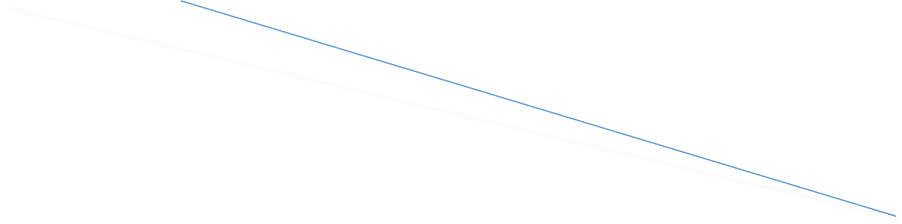


We create many feature maps to obtain our first convolution layer
Feature
0 | 0 | 0 | 0 | 0 | 0 | 0
0 | 1 | 0 | 0 | 0 | 1 | 0
0 | 0 | 0 | 0 | 0 | 0 | 0
0 | 0 | 0 | 1 | 0 | 0 | 0
0 | 1 | 0 | 0 | 0 | 1 | 0
0 | 0 | 1 | 1 | 1 | 0 | 0
0 | 0 | 0 | 0 | 0 | 0 | 0
Maps
Input Image
Convolutional Layer

Slide 20
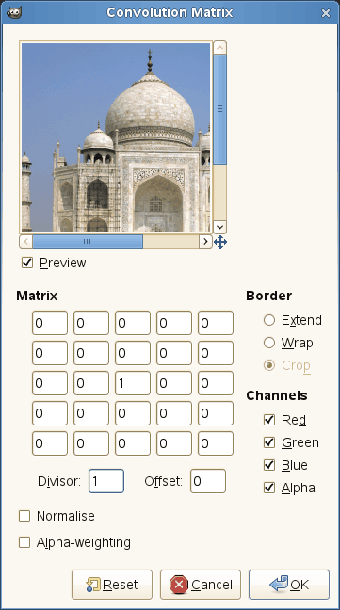
Image Source: docs.gimp.org/en/plug-in-convmatrix.html

Slide 21
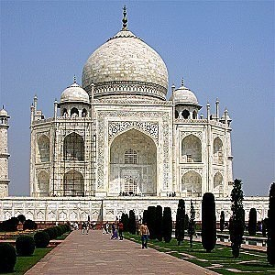
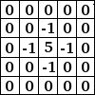
Sharpen:
Image Source: docs.gimp.org/en/plug-in-convmatrix.html

Slide 22
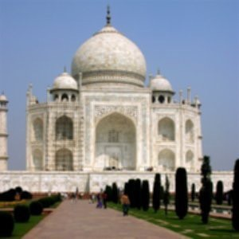
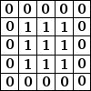
Blur:
Image Source: docs.gimp.org/en/plug-in-convmatrix.html

Slide 23
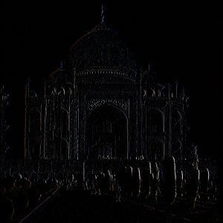
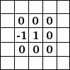
Edge Enhance:
Image Source: docs.gimp.org/en/plug-in-convmatrix.html

Slide 24
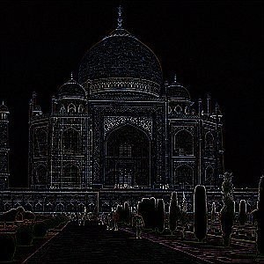
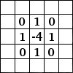
Edge Detect:
Image Source: docs.gimp.org/en/plug-in-convmatrix.html

Slide 25
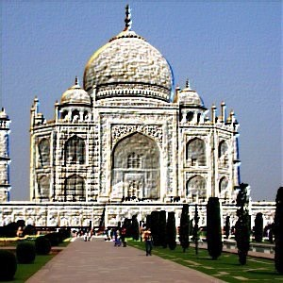
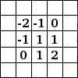
Emboss:
Image Source: docs.gimp.org/en/plug-in-convmatrix.html

Slide 26
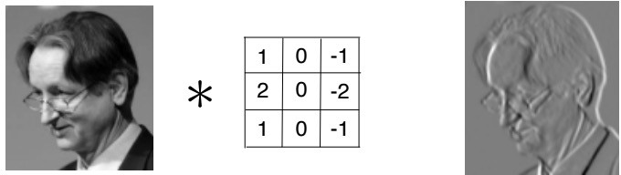
Image Source: eonardoaraujosantos.gitbooks.io

Slide 27






Slide 28

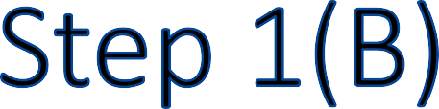





We create many feature maps to obtain our first convolution layer
Feature
0 | 0 | 0 | 0 | 0 | 0 | 0
0 | 1 | 0 | 0 | 0 | 1 | 0
0 | 0 | 0 | 0 | 0 | 0 | 0
0 | 0 | 0 | 1 | 0 | 0 | 0
0 | 1 | 0 | 0 | 0 | 1 | 0
0 | 0 | 1 | 1 | 1 | 0 | 0
0 | 0 | 0 | 0 | 0 | 0 | 0
Maps
Input Image
Convolutional Layer

Slide 29

















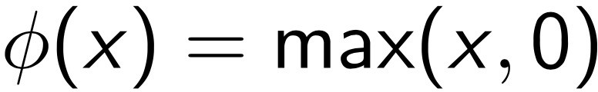








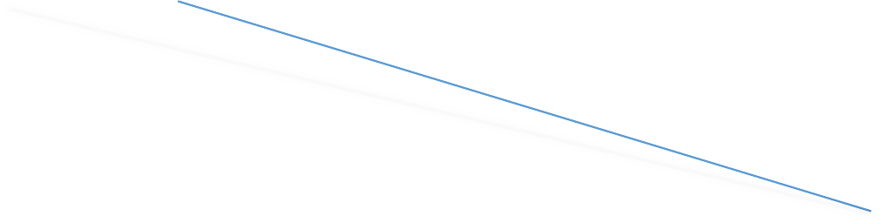




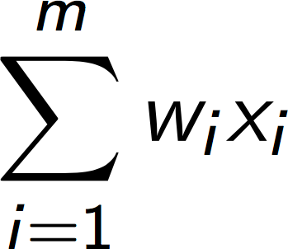

Rectifier
0 | 0 | 0 | 0 | 0 | 0 | 0
0 | 1 | 0 | 0 | 0 | 1 | 0
0 | 0 | 0 | 0 | 0 | 0 | 0
0 | 0 | 0 | 1 | 0 | 0 | 0
0 | 1 | 0 | 0 | 0 | 1 | 0
0 | 0 | 1 | 1 | 1 | 0 | 0
0 | 0 | 0 | 0 | 0 | 0 | 0
Feature Maps
y
0
Input Image
Convolutional Layer

Slide 30
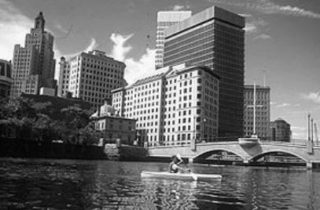
Image Source: http://mlss.tuebingen.mpg.de/2015/slides/fergus/Fergus_1.pdf

Slide 31
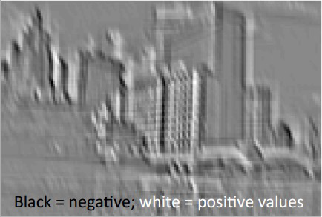
Image Source: http://mlss.tuebingen.mpg.de/2015/slides/fergus/Fergus_1.pdf

Slide 32
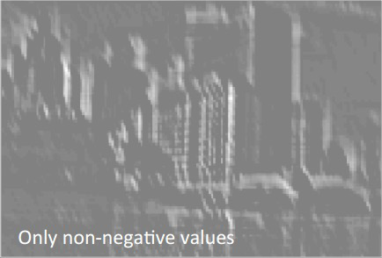
Image Source: http://mlss.tuebingen.mpg.de/2015/slides/fergus/Fergus_1.pdf

Slide 33

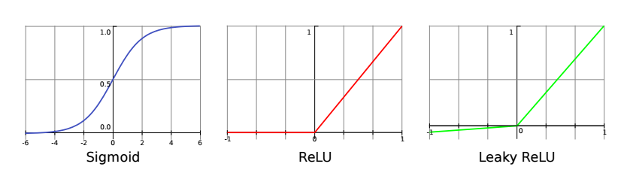
Additional Reading:
Understanding Convolutional Neural Networks with A
Mathematical Model
By C.-C. Jay Kuo (2016)
Link: https://arxiv.org/pdf/1609.04112.pdf

Slide 34

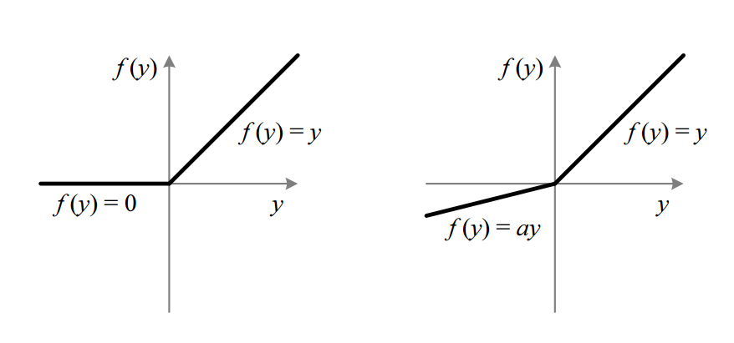
Additional Reading:
Delving Deep into Rectifiers: Surpassing Human-Level Performance on ImageNet Classification
By Kaiming He et al. (2015) Link:
https://arxiv.org/pdf/1502.01852.pdf

Slide 35







Slide 36




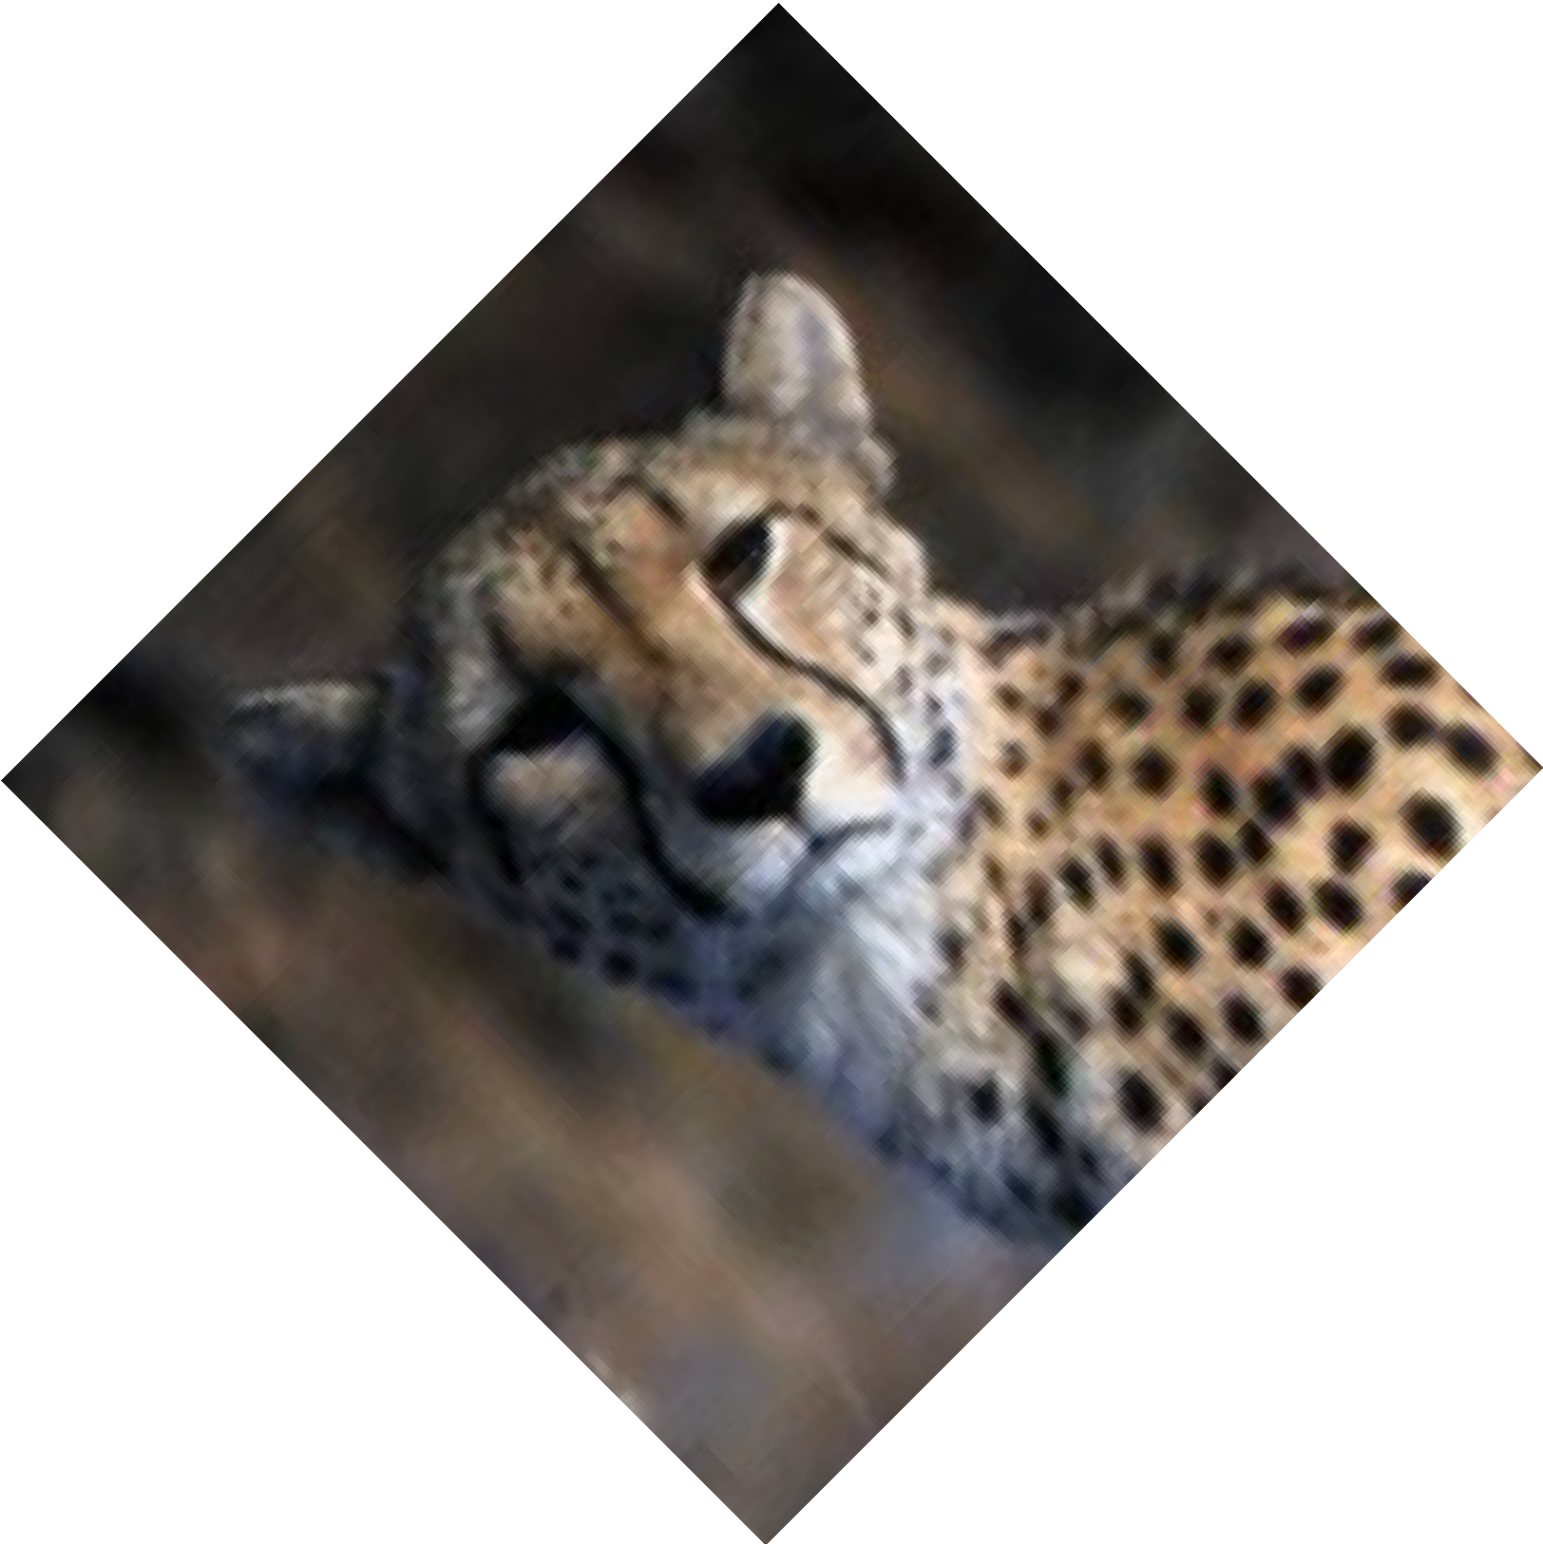
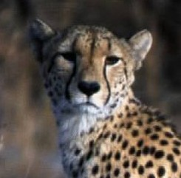

Image Source: Wikipedia

Slide 37
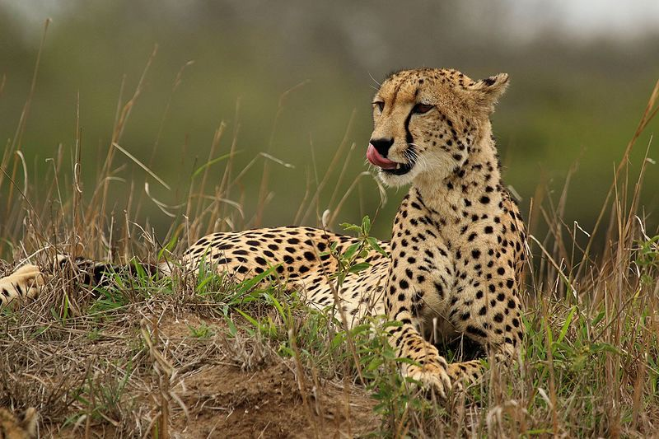
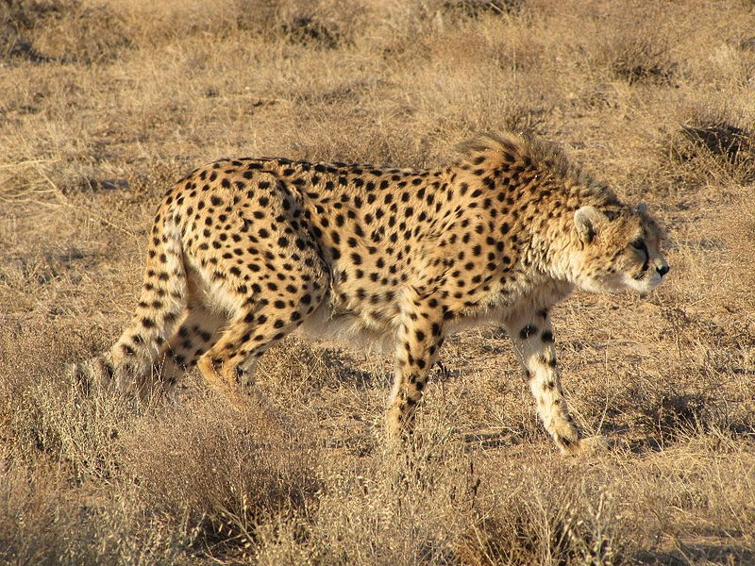
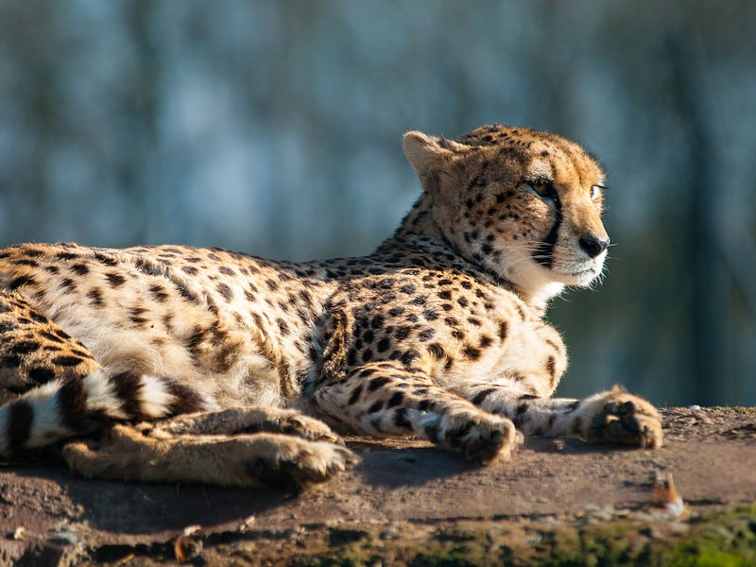
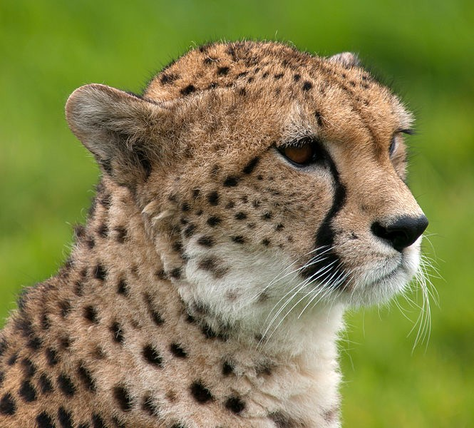
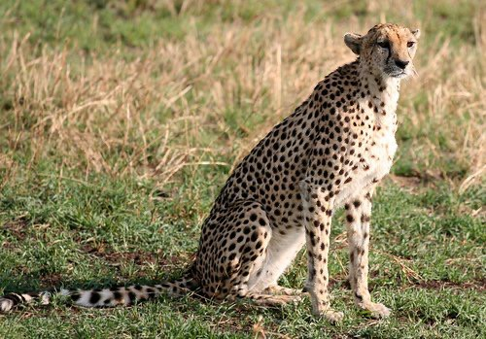
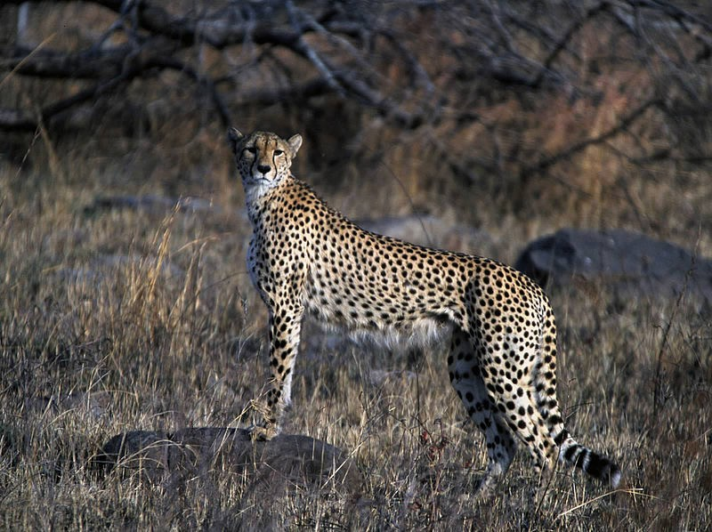
Image Source: Wikipedia

Slide 38
0 | 1 | 0 | 0 | 0
0 | 1 | 1 | 1 | 0
1 | 0 | 1 | 2 | 1
1 | 4 | 2 | 1 | 0
0 | 0 | 1 | 2 | 1
Feature Map

Slide 39
Max Pooling
0 | 1 | 0 | 0 | 0
0 | 1 | 1 | 1 | 0
1 | 0 | 1 | 2 | 1
1 | 4 | 2 | 1 | 0
0 | 0 | 1 | 2 | 1
Pooled Feature Map
Feature Map

Slide 40

Max Pooling
0 | 1 | 0 | 0 | 0
0 | 1 | 1 | 1 | 0
1 | 0 | 1 | 2 | 1
1 | 4 | 2 | 1 | 0
0 | 0 | 1 | 2 | 1
1
Pooled Feature Map
Feature Map

Slide 41

Max Pooling
0 | 1 | 0 | 0 | 0
0 | 1 | 1 | 1 | 0
1 | 0 | 1 | 2 | 1
1 | 4 | 2 | 1 | 0
0 | 0 | 1 | 2 | 1
1 | 1
Pooled Feature Map
Feature Map

Slide 42

Max Pooling
0 | 1 | 0 | 0 | 0
0 | 1 | 1 | 1 | 0
1 | 0 | 1 | 2 | 1
1 | 4 | 2 | 1 | 0
0 | 0 | 1 | 2 | 1
1 | 1 | 0
Pooled Feature Map
Feature Map

Slide 43

Max Pooling
0 | 1 | 0 | 0 | 0
0 | 1 | 1 | 1 | 0
1 | 0 | 1 | 2 | 1
1 | 4 | 2 | 1 | 0
0 | 0 | 1 | 2 | 1
1 | 1 | 0
4
Pooled Feature Map
Feature Map

Slide 44

Max Pooling
0 | 1 | 0 | 0 | 0
0 | 1 | 1 | 1 | 0
1 | 0 | 1 | 2 | 1
1 | 4 | 2 | 1 | 0
0 | 0 | 1 | 2 | 1
1 | 1 | 0
4 | 2
Pooled Feature Map
Feature Map

Slide 45

Max Pooling
0 | 1 | 0 | 0 | 0
0 | 1 | 1 | 1 | 0
1 | 0 | 1 | 2 | 1
1 | 4 | 2 | 1 | 0
0 | 0 | 1 | 2 | 1
1 | 1 | 0
4 | 2 | 1
Pooled Feature Map
Feature Map

Slide 46

Max Pooling
0 | 1 | 0 | 0 | 0
0 | 1 | 1 | 1 | 0
1 | 0 | 1 | 2 | 1
1 | 4 | 2 | 1 | 0
0 | 0 | 1 | 2 | 1
1 | 1 | 0
4 | 2 | 1
0
Pooled Feature Map
Feature Map

Slide 47

Max Pooling
0 | 1 | 0 | 0 | 0
0 | 1 | 1 | 1 | 0
1 | 0 | 1 | 2 | 1
1 | 4 | 2 | 1 | 0
0 | 0 | 1 | 2 | 1
1 | 1 | 0
4 | 2 | 1
0 | 2
Pooled Feature Map
Feature Map

Slide 48

Max Pooling
0 | 1 | 0 | 0 | 0
0 | 1 | 1 | 1 | 0
1 | 0 | 1 | 2 | 1
1 | 4 | 2 | 1 | 0
0 | 0 | 1 | 2 | 1
1 | 1 | 0
4 | 2 | 1
0 | 2 | 1
Pooled Feature Map
Feature Map

Slide 49

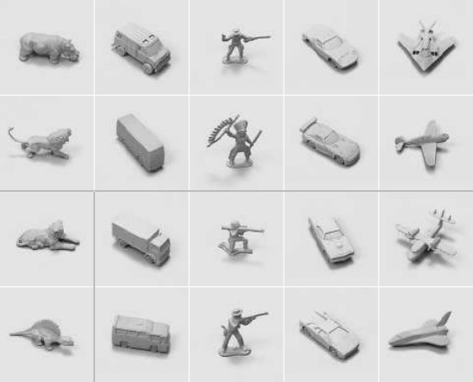
Additional Reading:
Evaluation of Pooling
Operations in Convolutional Architectures for Object Recognition
By Dominik Scherer et al. (2010) Link:
http://ais.uni-bonn.de/papers/icann2010_maxpool.pdf

Slide 50




















0 | 0 | 0 | 0 | 0 | 0 | 0
0 | 1 | 0 | 0 | 0 | 1 | 0
0 | 0 | 0 | 0 | 0 | 0 | 0
0 | 0 | 0 | 1 | 0 | 0 | 0
0 | 1 | 0 | 0 | 0 | 1 | 0
0 | 0 | 1 | 1 | 1 | 0 | 0
0 | 0 | 0 | 0 | 0 | 0 | 0
Convolution
Pooling
Input Image
Convolutional Layer
Pooling Layer

Slide 51


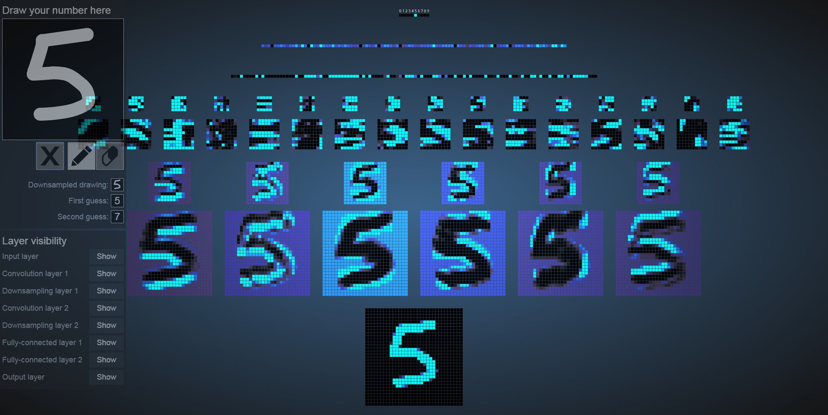
Image Source: scs.ryerson.ca/~aharley/vis/conv/flat.html

Slide 52




Slide 53





1 | 1 | 0
4 | 2 | 1
0 | 2 | 1
Pooled Feature Map

Slide 54
Flattening
1
1
0
4
2
1
0
2
1
1 | 1 | 0
4 | 2 | 1
0 | 2 | 1
Pooled Feature Map

Slide 55















Flattening
Input layer of a future ANN
Pooling Layer

Slide 56



























0 | 0 | 0 | 0 | 0 | 0 | 0
0 | 1 | 0 | 0 | 0 | 1 | 0
0 | 0 | 0 | 0 | 0 | 0 | 0
0 | 0 | 0 | 1 | 0 | 0 | 0
0 | 1 | 0 | 0 | 0 | 1 | 0
0 | 0 | 1 | 1 | 1 | 0 | 0
0 | 0 | 0 | 0 | 0 | 0 | 0
Convolution
Pooling
Flattening
Input Image
Input layer of a future ANN
Convolutional Layer
Pooling Layer

Slide 57





Slide 58







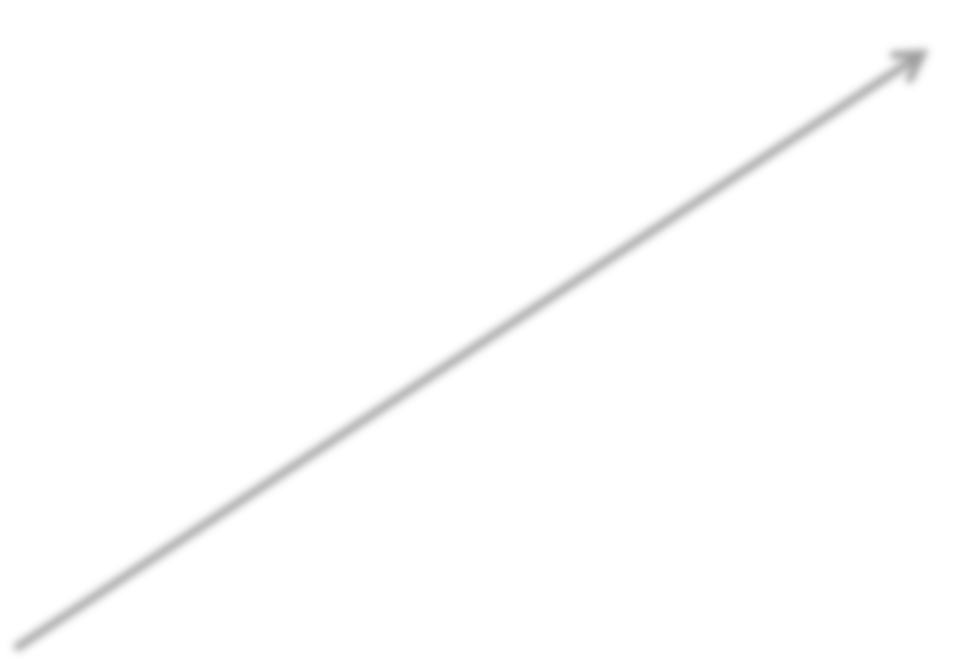

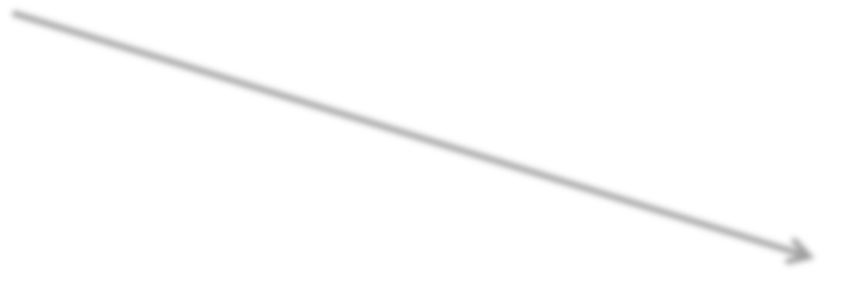


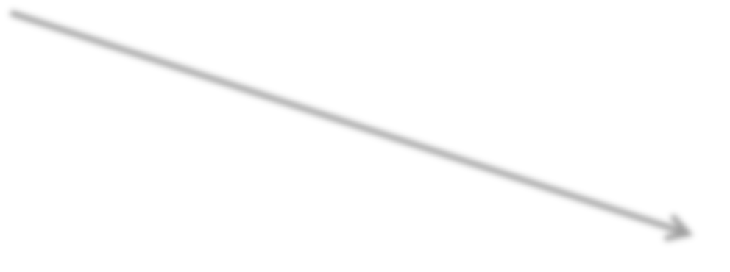
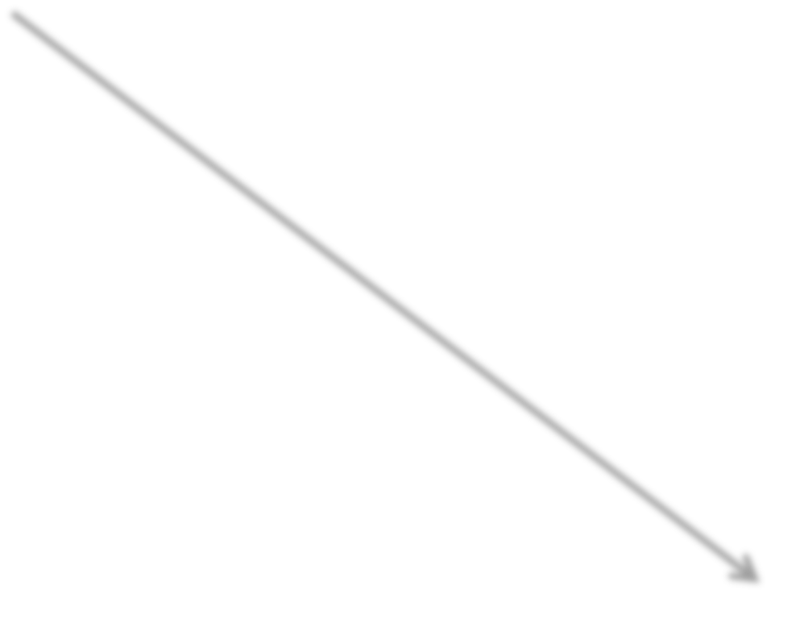






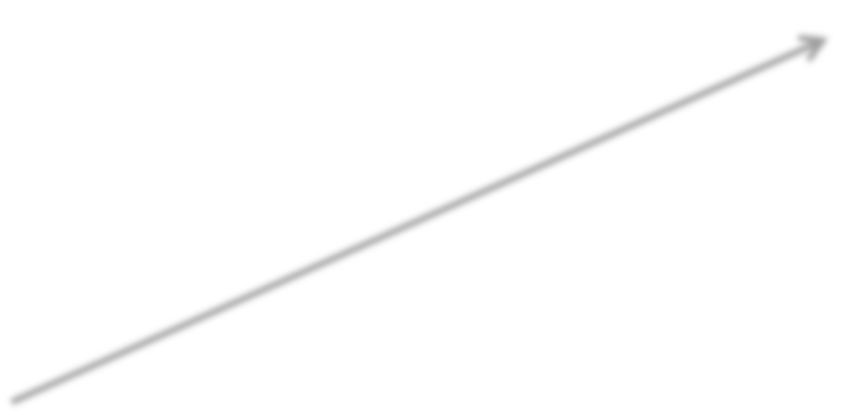
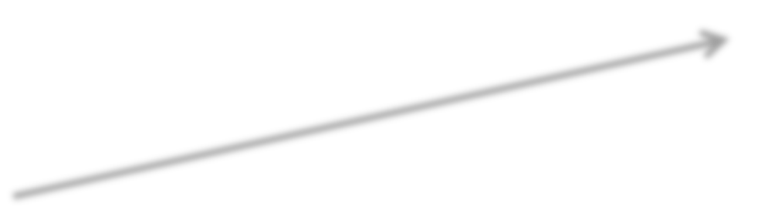

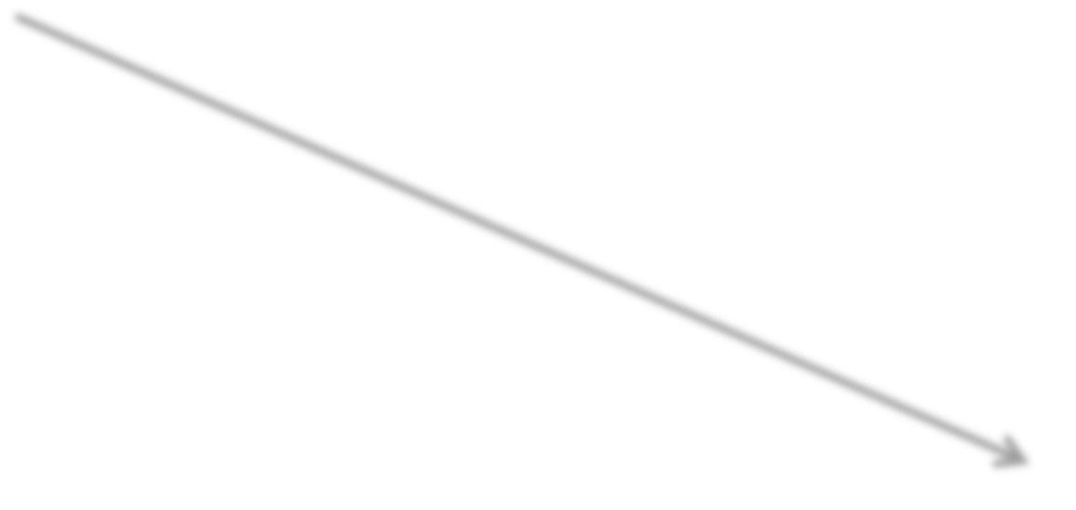


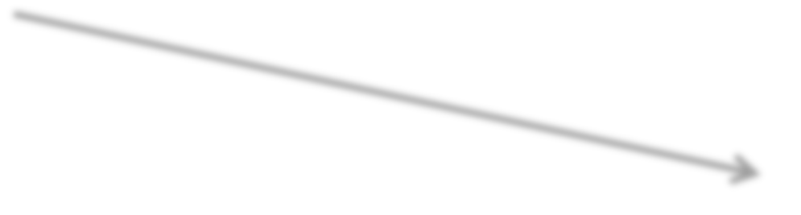

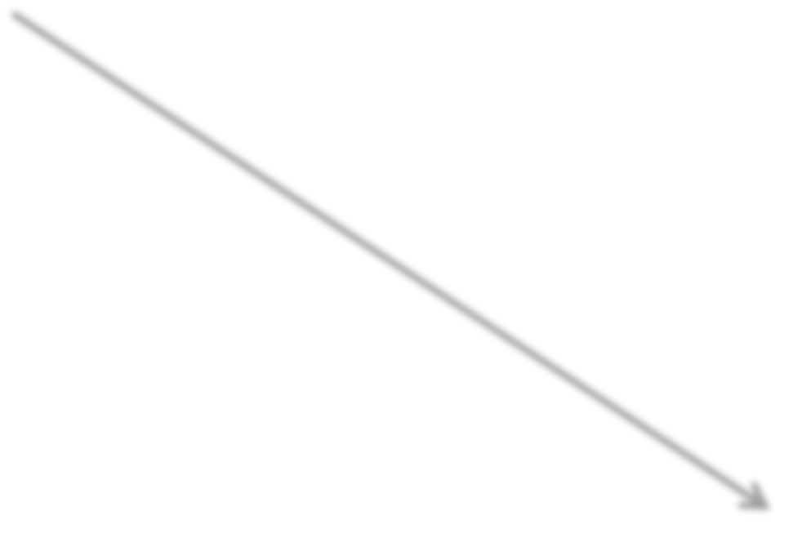


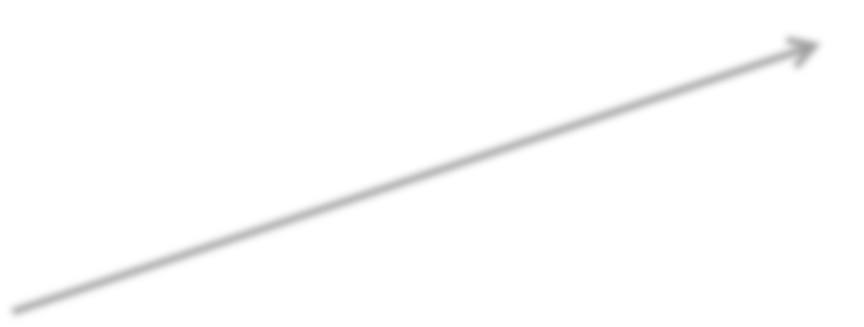


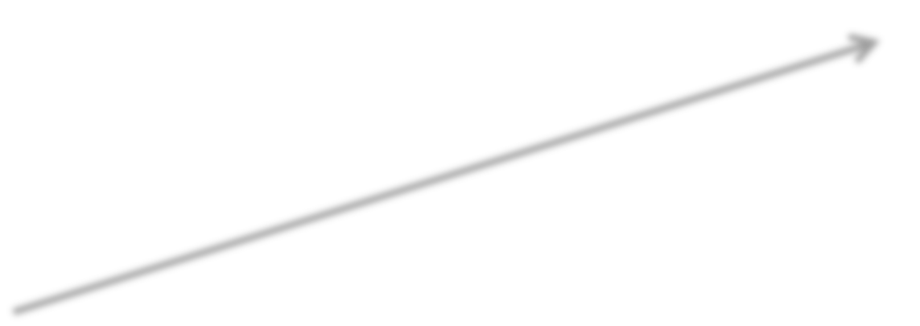







X1
y
Flattening
X2
Output value
y
Xm
Input Layer
Fully Connected Layer
Output Layer

Slide 59



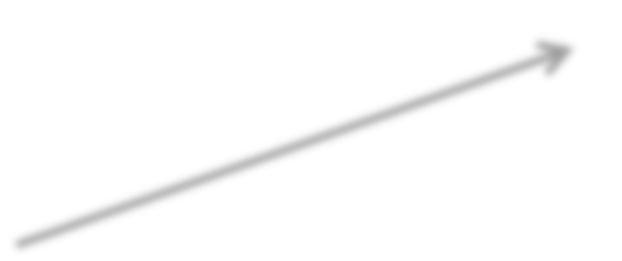
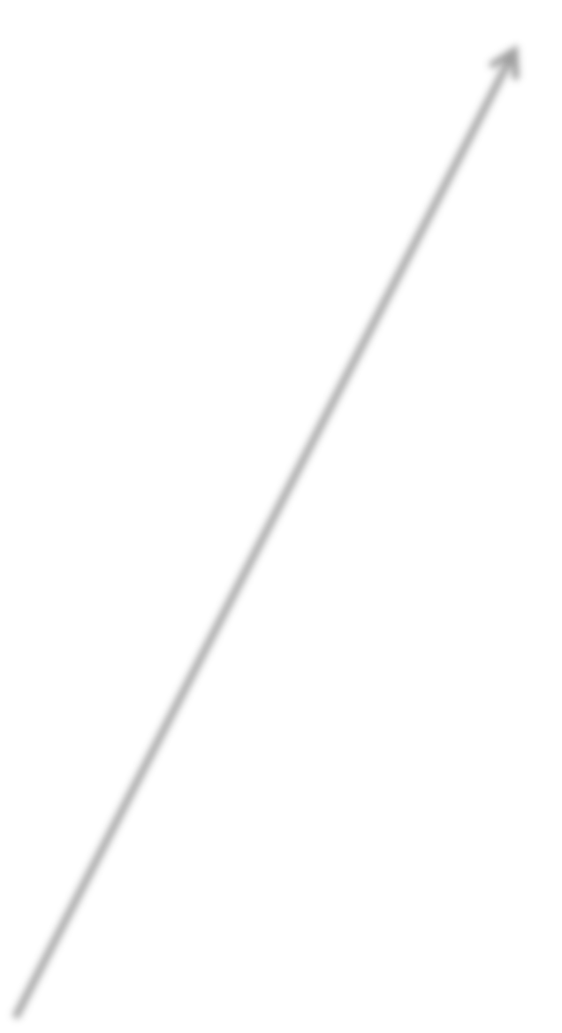





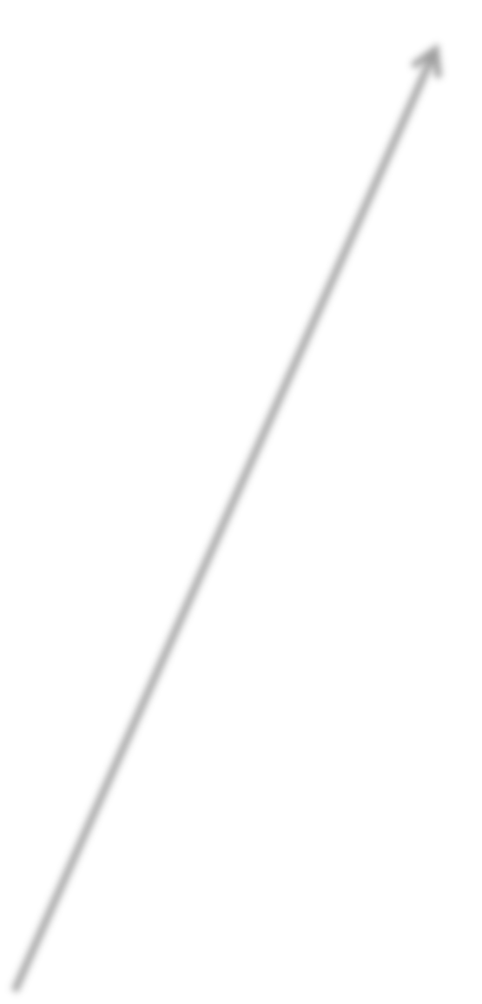





































































































Dog
Flattening
Cat

Slide 60


Dog
Flattening
Cat

Slide 61






0.9
1
0.2
Dog
Flattening
0.1
0.2
Cat
1
0.1
0.1

Slide 62




























0.9
1
0.2
Dog
Flattening
0.1
0.2
Cat
1
0.1
0.1

Slide 63


Dog
Flattening
Cat

Slide 64

0.1
0.2
0.9
Dog
Flattening
0.2
0.9
Cat
0.1
0.2
1

Slide 65













0.1
0.2
0.9
Dog
Flattening
0.2
0.9
Cat
0.1
0.2
1

Slide 66


Dog
Flattening
Cat

Slide 67


1
1
0.1
Dog 0.95
Flattening
0.4
0.8
Cat 0.05
0.8
0.1
0.2

Slide 68




0.1
0.8
0.4
Dog 0.21
Flattening
0.9
1
Cat 0.79
0.2
0.1
1

Slide 69


Image Source: a talk by Geoffrey Hinton

Slide 70


Slide 71








Slide 72


Additional Reading:
The 9 Deep Learning Papers You Need To Know About (Understanding CNNs Part 3)
Adit Deshpande (2016)
Link:
https://adeshpande3.github.io/adeshpande3.github.io/The-9-Deep- Learning-Papers-You-Need-To-Know-About.html

Slide 73






Slide 74








Dog 0.95
Flattening
Cat 0.05

Slide 75
































































































































0.95
Dog
z₁
Flattenin g
Cat
z₂
0.05

Slide 76



Slide 77







Dog 0.9
1
0
Cat
0.1

Slide 78
























Dog | 1 | 0.9 | 0.6
Cat | 0 | 0.1 | 0.4
Dog | 0 | 0.1 | 0.3
Cat | 1 | 0.9 | 0.7
Dog ¹ 0.4 |  |  | 0.1
Cat | 0 | 0.6 | 0.9

